Slide 1





Learning MCDA with the help of diviz

Slide 2

Index of the presentation:
Aim and scope of the contribution
Description of the MOOC
The role of diviz in the course
Using diviz to learn MCDA
Using diviz to understand ELECTRE III
Using diviz to understand UTA
Using diviz to fully develop a case study
Thinking about what we have achieved

Slide 3
Aim and scope
We present a contribution dealing with the use of diviz as an application for working with multicriteria decision aid cases/examples in the framework of a MOOC.
The MOOC is oriented to beginners.
The MOOC has been developed by the Grenoble Alpes Université, Universisité Savoie-Mont Blanc (both in France) and Rey Juan Carlos University (Madrid, Spain)
The course is available on the Fun platform
https://www.fun-mooc.fr/courses/course-v1:grenoblealpes+92008+session01bis/about

Slide 4
Aim and scope
The idea in this MOOC is not that students are able to design the flowcharts themselves. They do not have enough theoretical understanding of the methods. On the contrary, it is that, given a flow diagram of a specific method, they are able to use it at the user level: enter the data and parameters necessary for the program to provide a solution. Likewise, students must be able to interpret the results obtained.

Slide 5
Description of the MOOC
About the course:
This course is aimed at a public, student or professional, who wants to know more about the tools to make "reasonable" decisions. It is aimed at non-specialists.
The idea is to situate the context of decision-making when the optimization of a single criterion is not sufficient.
The essential of the field is presented (typology of the problems of decision, concept of scale, outranking and aggregation) before detailing some methods among the most used (AHP, ELECTRE III, MACBETH and UTA).
The pedagogy is based on video capsules accompanied by works of appropriation of key concepts and multiple choice questions that validate understanding.
The methods are illustrated through a simple problem where studentes are guided by the authors and then a “near” real problem.

Slide 6
Description of the MOOC
Format:
The course will run for 11 weeks:
  8 weeks of content (videos, quizzes, training exercises),
  plus 3 extra weeks dedicated to working on a case study of student’s choice from 3.
  A 2 week break will be observed at the time of Christmas holidays (from 23/12/2017 to 03/01/2018)
First edition of the course: from November 2017 to February 2018
Second edition will start on spring 2019

Slide 7
Description of the MOOC
Prerequisites:
Having been confronted with decision situations.
Basic mathematical notions (matrix, linear programming, algebra)
Intellectual curiosity
Educational team:
Vincent Clivillé: Associate Professor in Automatics, University Savoie Mont Blanc.
María A. de Vicente y Oliva: Professor of Statistics, Universidad Rey Juan Carlos Madrid
Jaime Manera Bassa: Professor of Marketing, Universidad Rey Juan Carlos Madrid

Slide 8
Description of the MOOC
The MOOC is not an exhaustive course in terms of presenting approaches and methods.
Some methods of AMCD and the corresponding application software are proposed.
Our philosophy has been to look for free software or to have free trial versions.

Slide 9
Description of the MOOC
Course Index:
Week 1: Introduction, presentation of the meta-example and typology of decision problems
Week 2: The search for an optimal solution and the notion of scale
Week 3: The main approaches
Week 4: The diviz platform
Week 5: The AHP Method
Week 6: The ELECTRE Methods
Week 7: The MACBETH Method
Week 8: The UTA method
Week 9: Work on the Case Study
Week 10 and 11: Peer Review of the Case Study

Slide 10
Description of the MOOC
Evaluation:
A certificate of “follow-up with success” will be issued to participants with:
successful quizzes from weeks 1 to 7
a work on the meta-example (weeks 5 to 7)
the completion of a case study (chosen among 3) and the evaluation of 3 assignments rendered by the other participants

Slide 11
Description of the MOOC
Balance Assessment:
4567 registered registrations from very many countries, a majority in France and French-speaking Africa.
615 started Mooc, 42 completed it.
The forum collected dozens of questions per week and answered them.
Additional explanations for the course were sometimes necessary and in particular for the notion of dominance.
602 hours of officially recorded work, triple in reality
Two heavy technical problems encountered:
  Access to diviz platform
  Installation of Java previously to access to the web service to Web-Hipre (Java).
  The absence of a Mac version for M-MACBETH

Slide 12
The role of diviz in the course
The idea of ​​the MOOC is to work with free software when developing the examples and cases proposed for the different methods.
In this context, diviz has been used to apply ELECTRE III and UTA.
Previously to the explanation of the different methods of MCDA, there is a chapter in which diviz is introduced.
diviz is presented with the help of an example.

Slide 13
The role of diviz in the course
Course Index:
Week 1: Introduction, presentation of the meta-example and typology of decision problems
Week 2: The search for an optimal solution and the notion of scale
Week 3: The main approaches
Week 4: The DIVIZ platform
Week 5: The AHP Method
Week 6: The ELECTRE Methods
Week 7: The MACBETH Method
Week 8: The UTA method
Week 9: Work on the case study
Week 10 and 11: Peer Review of the Case Study

Slide 14
Using diviz to learn MCDA
Week 4:
diviz is introduced.
diviz interface is presented and the philosophy of the software is described
Workflow design:
To build AMCD workflows, we use an intuitive graphic interface.
Each algorithm or information processing is represented by a box (in gray).
This box is linked to data files (in blue) or additional calculation elements (other boxes in gray) to using connectors.

Slide 15
Using diviz to learn MCDA
The emphasis is not on the theory but on converting diviz into a tool at the user level.
Students are given an example of workflow and are taught to enter the data of a problem (start at the end)
Data are introduced through files with csv format (the structure of the data files is explained in detail)
Results obtained:
Students face, without much theoretical knowledge, a classic decision problem (an example of ranking-ELECTRE III).
The students think about the structure of the criteria, the meaning of the weights of the criteria, the definition of the alternatives and the need to introduce some other parameters in the problem (in the example proposed the preference, indifference and veto thresholds)

Slide 16
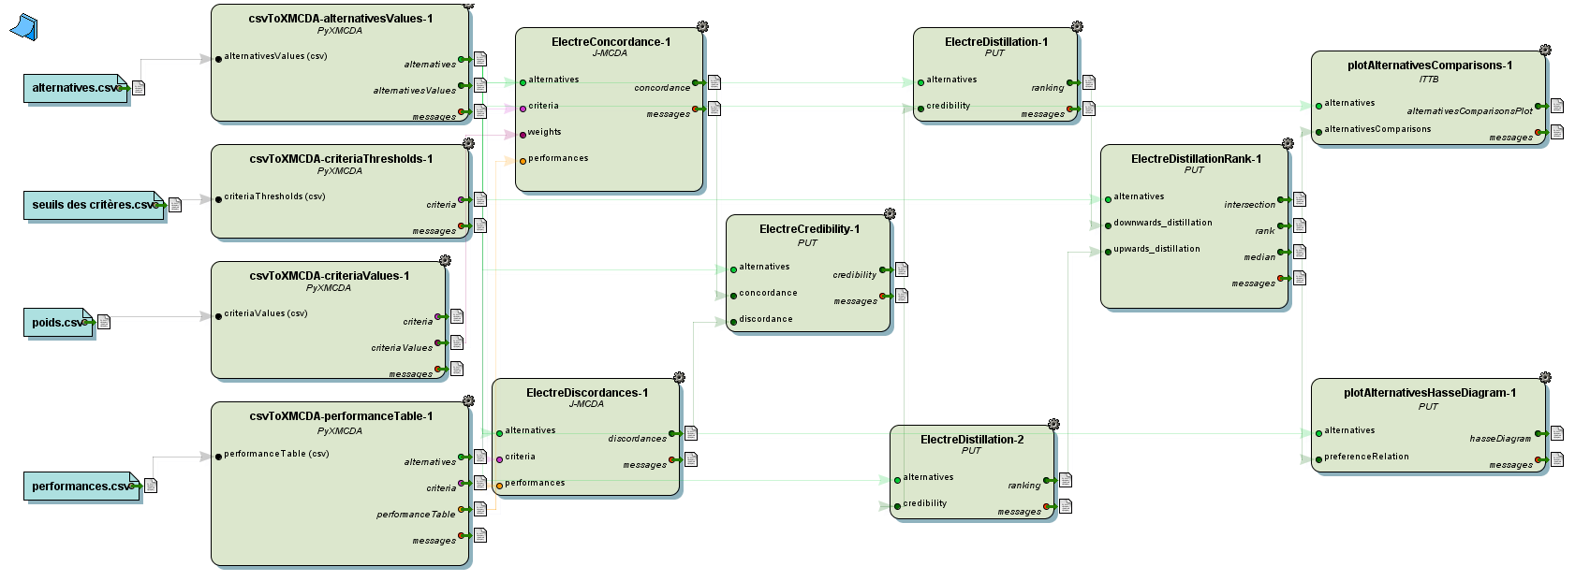
Using diviz to learn MCDA

Slide 17
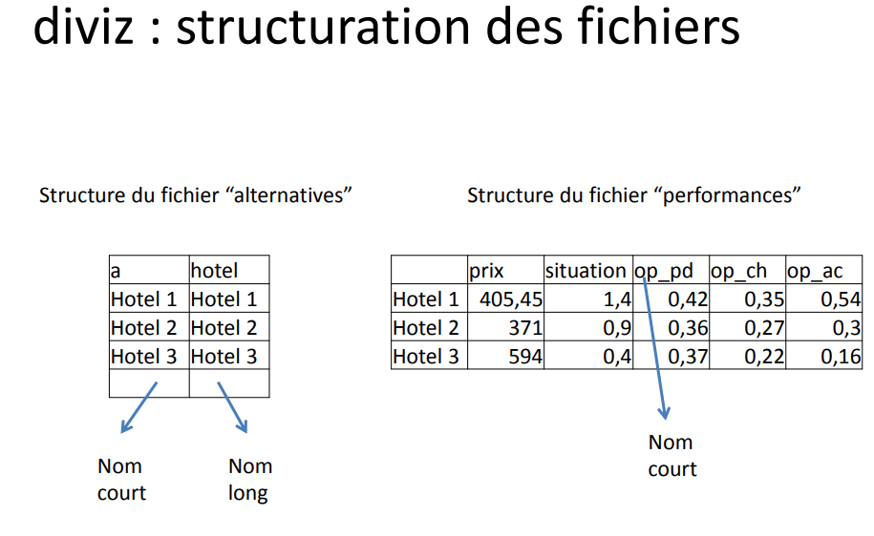
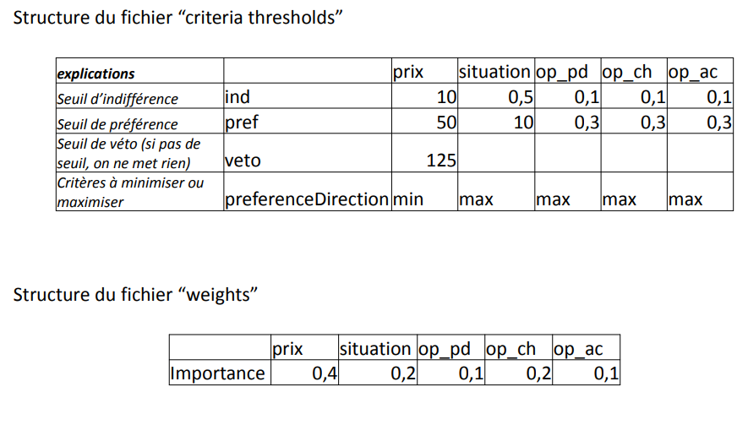
Using diviz to learn MCDA
EXAMPLE:

Slide 18
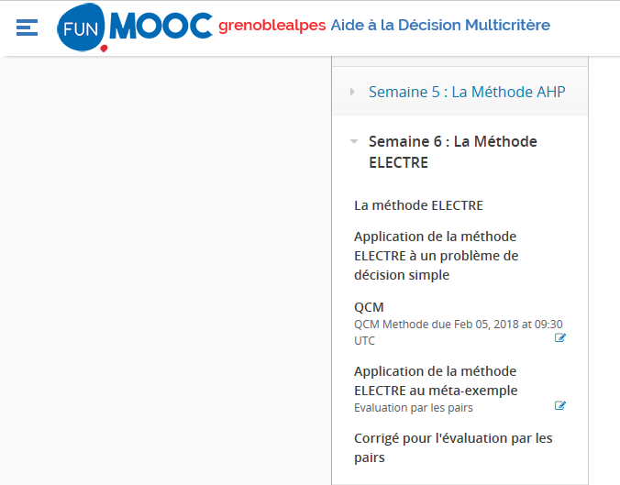
Using diviz to understand ELECTRE III
Methodological introduction: theory.
Resolution of a simple problem with diviz
Theoretical exercises
Study of the metaexample with diviz

Slide 19
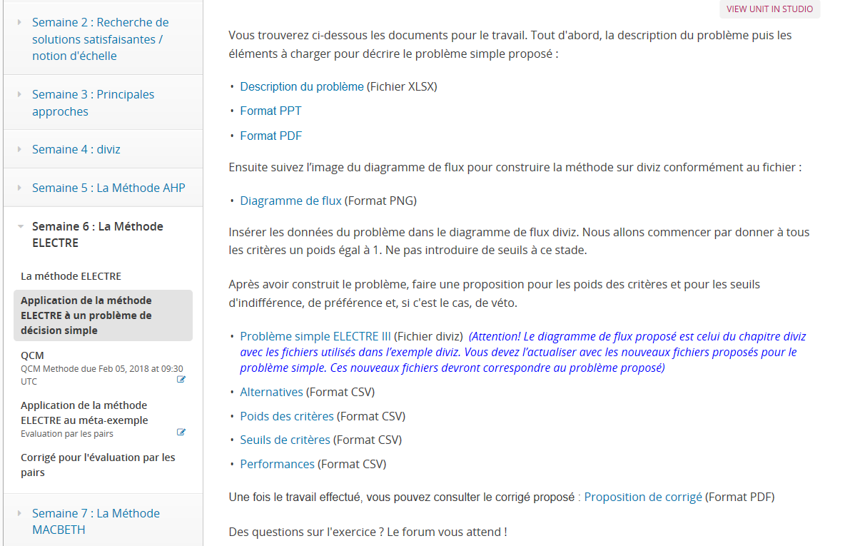
Using diviz to understand ELECTRE III

Slide 20
Using diviz to understand ELECTRE III
Resolution of a simple problem with diviz:
You will find below the documents for the work. First, the description of the problem then the elements
to be loaded to describe the simple problem proposed:
Description of the problem (XLSX File)
Then follow the workflow image to build the diviz workflow:
Workflow (Format PNG)
Insert the data of the problem into the diviz workflow. We will start by giving all the criteria a weight equal to 1. Do not introduce thresholds at this stage. After having constructed the problem, make a proposal for the weights of the criteria and for the indifference, preference and, if it is the case, of veto thresholds.
Simple problema ELECTRE III (diviz File) (Warning! The workflow proposed is that of the diviz chapter with the files used in the diviz example. You must refresh it with the new files proposed for the simple problem)
Alternatives (Format CSV)
Criteria weights (Format CSV)
Criteria thresholds (Format CSV)
Performances (Format CSV)
Once the work is done, a proposal for the solution/final recommendation can be consulted.

Slide 21
Using diviz to understand ELECTRE III
Resolution of a simple
problem with diviz :

Slide 22
Using diviz to learn ELECTRE III
Study of the METAEXAMPLE with diviz, practising ELECTRE III:

Slide 23
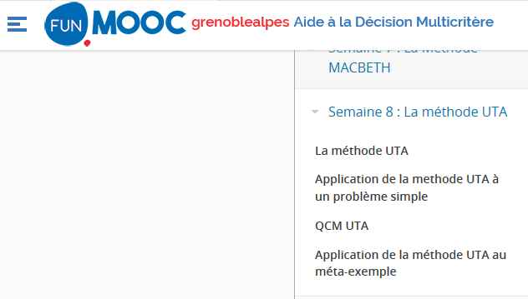
Using diviz to learn UTA

Slide 24
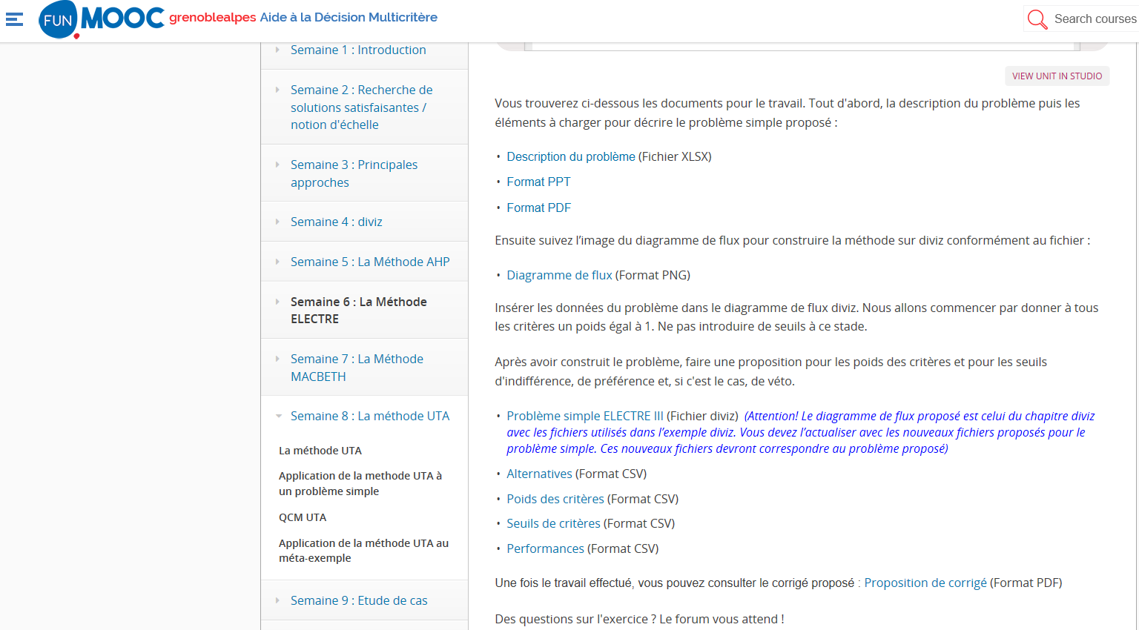
Using diviz to learn UTA

Slide 25
Using diviz to learn UTA
When we use diviz in the framework of UTA, students already know the software and the platform.
Here we will have to emphasize on:
The construction of the csv files. They are different from the ones of ELECTRE III. In fact, some of the parameters doesn’t exist here (indifference, preference and veto thresholds)
The solutions proposed by diviz are also different from the ELECTRE III ones, and the interpretation as well.
That is, we force students to think about the method itself: the information it demands and the solutions it provides.

Slide 26
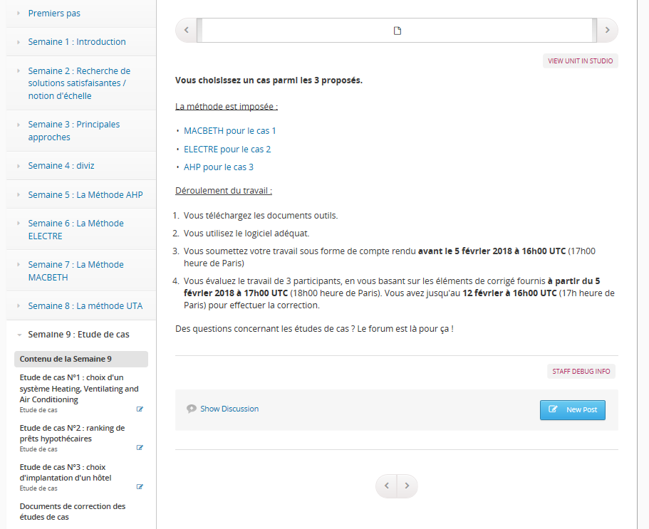
Using diviz to fully develop a case study
Work development:
You download the tool documents (data file in excel format)
You use the appropriate software.
You submit your work as a report before February 5, 2018 at 16:00 UTC (5:00 pm Paris time)
You evaluate the work of 3 participants, based on the corrected elements provided from February 5, 2018 at 17:00 UTC (18:00 Paris time). You have until February 12 at 16:00 UTC (17h Paris time) to make the correction.
Ranking of mortgage loans

Slide 27
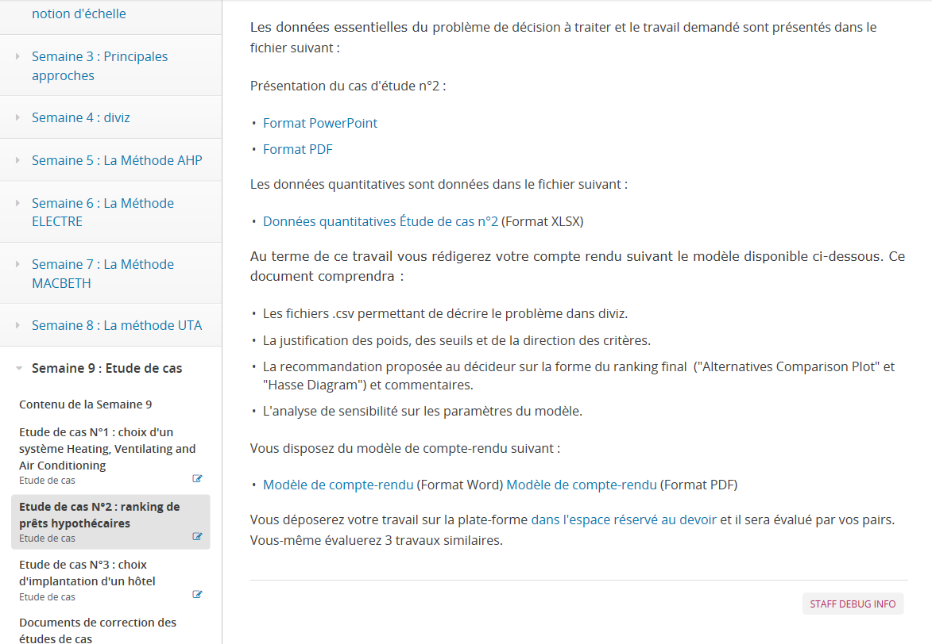
Using diviz to fully develop a case study
At the end of this work you will write your report following the model available below. This document will include:
The .csv files to describe the problem in diviz.
The justification of the weights, thresholds and direction of the criteria.
The recommendation proposed to the decision maker on the form of the final ranking ("Alternatives Comparison Plot" and "Hasse Diagram") and comments. Sensitivity analysis on the model parameters.
You have the following reporting template:
Report Template (Word Format) Report Template (PDF Format)
You will place your work on the platform in the assignment space and it will be evaluated by your peers.
You yourself will evaluate 3 similar works.

Slide 28
Thinking about what we have achieved
IDEAS
SUGGESTIONS
………….

Slide 29
Thinking about what we have achieved
We have used diviz as a remote (online) learning tool for the MCDA.
Initially, we thought that it could be an added difficulty. But it has not been.
We have used the meta-example throughout the course. We have applied the different methods considered to this meta-example.
However, for the case studies we have forced to use a certain method in each of them (depending on the approach of the problem and the available information)

Slide 30

Thank you!

