Slide 1

Using PROMETHEE to rank the EU countries on Environmental Health and Ecosystem Vitality
Panagiota DIGKOGLOU
Department of Business Administration, University of Macedonia, Thessaloniki, Greece
giotadigkogloul@outlook.com
Jason PAPATHANASIOU
Department of Business Administration, University of Macedonia, Thessaloniki, Greece
jasonp@uom.edu.gr
DDWS15 - 15th Decision Deck Workshop
26 September 2018, Lisbon, Portugal

Slide 2
INTRODUCTION
The purpose of this work is to examine the course of the EU countries over the chosen decade.
We processed the data with the diviz software and with the Visual PROMETHEE.
The source of the data is a part of the Environmental Performance Index (EPI), which is published by Yale University and Columbia University every two years.

Slide 3
LITERATURE REVIEW
An increasing interest and concern for environmental problems and quality of life.
The European Union is characterized by a high concern for the environmental issues.
There are many publications, which are focused on the Environmental Performance Index.
There is a gap between the EPI and the multi-criteria analysis methods.
One relative publication to a sensitivity analysis of the EPI has presented by Saisana and Saltelli (2008).

Slide 4
ENVIRONMENTAL PERFORMANCE INDEX
Today, EPI ranks more than 200 countries on several performance indicators across specific categories related to environmental health and ecosystem vitality.
It is developed by Yale University and Columbia University in collaboration with the World Economic Forum.
It includes issues about quality of human health, air, sanitation and water, treatment of wastewater, levels of nitrogen, loss of tree cover, fish stocks, protection of biodiversity and habitant and also measurements about climate and energy.

Slide 5
ENVIRONMENTAL PERFORMANCE INDEX
Raw datasets are transferred to standardized and comparable performance indicators.
The transformed data are used for the calculation of performance indicators, using a “proximity-to-target” methodology, which measures how close a specific country is to a defined target.
  National or international policy goals or established scientific threshold.
  The arithmetic scale is from 0 to 100.
  There are weights, which are estimated through the quality of the underlying dataset, as well as the relevance or fit of the indicator to assess the policy issue.

Slide 6
ENVIRONMENTAL PERFORMANCE INDEX
We will use as two criteria the indicators Environmental Health and Ecosystem Vitality.
The Environmental Health includes smaller indicators, which are;
  Climate & Energy
  Biodiversity & Habitat
  Fisheries
  Forests
  Agriculture
  Water resources
In the same way, the Ecosystem Vitality includes other indicators;
  Health impacts
  Air quality
  Water & Sanitation

Slide 7
PROMETHEE
It belongs to the family of outranking methods.
PROMETHEE I (partial ranking) and PROMETHEE II (global ranking) were firstly developed by Jean-Pierre Brans (1982) and a few years later PROMETHEE III and PROMETHEE IV were developed by Brans and Mareschall (1998).
It is based on three general steps:
  1. It calculates the preference degrees for every action on every criterion.
  2. It calculates the unicriterion flow of every criterion.
  3. It calculates the global flows of all criterions.

Slide 8
The Decision Deck project - diviz
The diviz software platform is a part of the Decision Deck project, which aims at collaboratively developing open source software tools implementing Multiple Criteria Decision Aid (MCDA), with a rising interest in the scientific community.
It can be used by several users, like teachers who use MCDA methods, researchers who want to compare methodologies or to create a new one, and practitioners who want to implement the MCDA to problems of the real world.
The diviz software is a tool, which includes many MCDA methodologies and it is used for designing, executing and deploying those MCDA methods.

Slide 9
CASE STUDY
Data Description
We have 6 scenarios with the chosen years, 2 criteria (Environmental Health and Ecosystem Vitality) and the 28 EU countries as alternatives.
We will process our data with the diviz software and also with the Visual PROMETHEE.

Slide 10
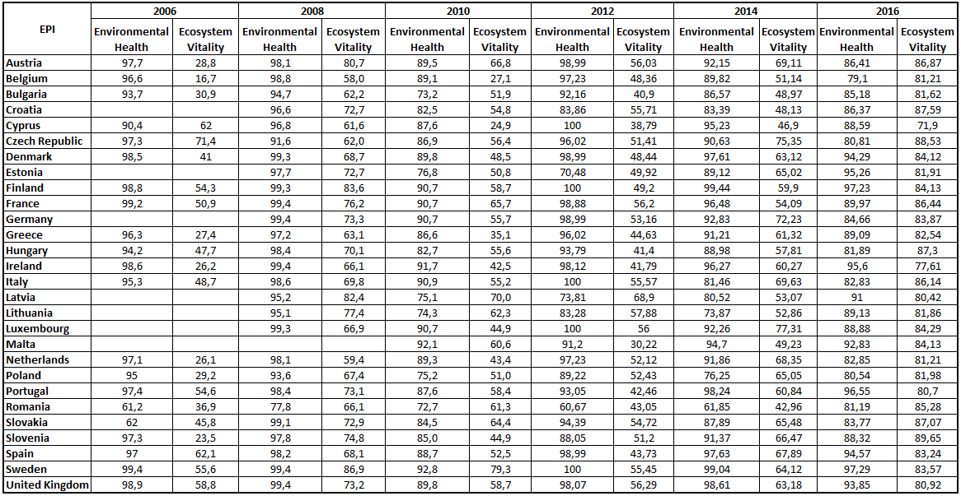
CASE STUDY
Data Description
Table 1: Data

Slide 11
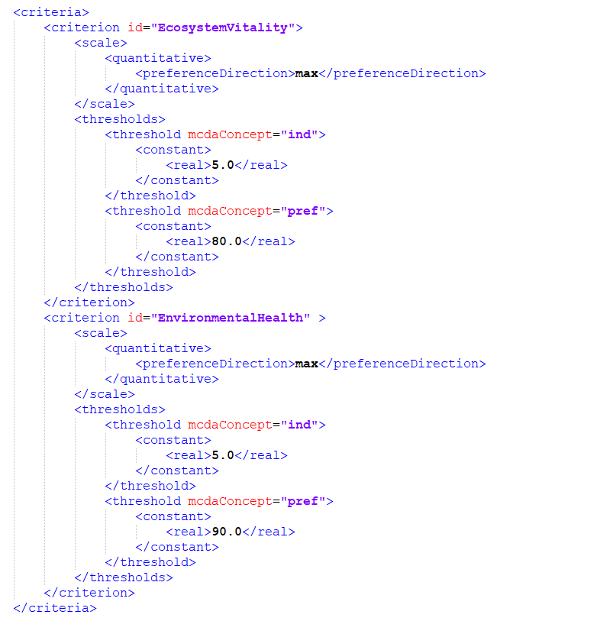
CASE STUDY - diviz
Figure 1: Criteria on the XML file

Slide 12
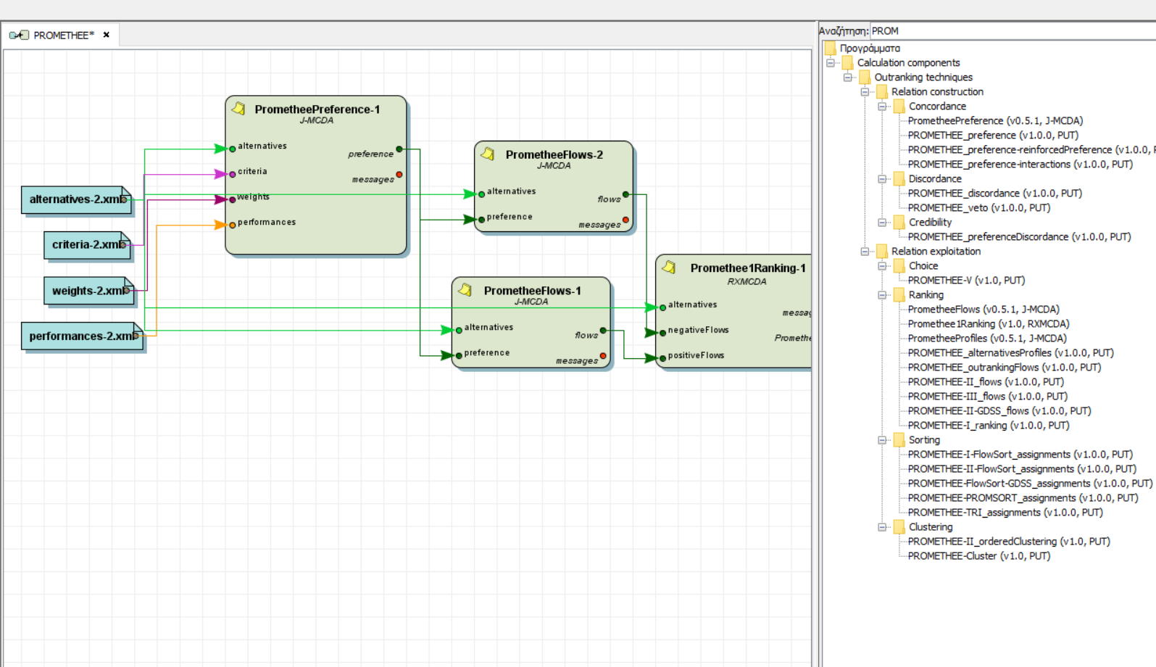
CASE STUDY - diviz
Figure 2: the diviz software

Slide 13
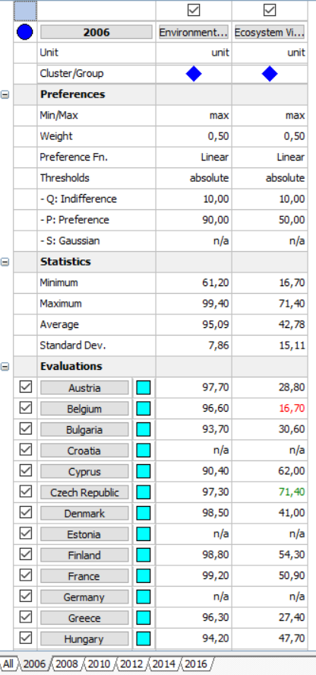
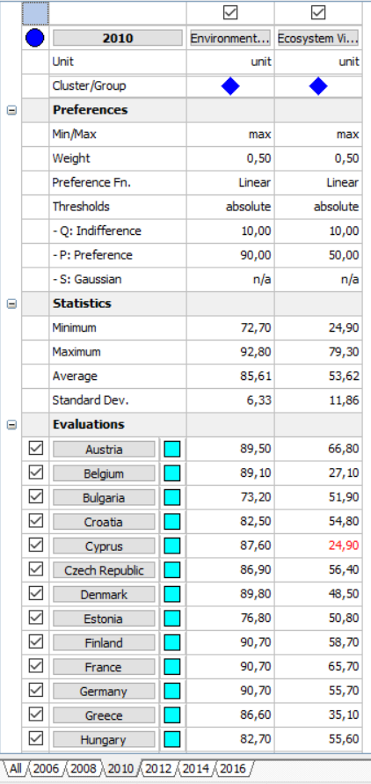
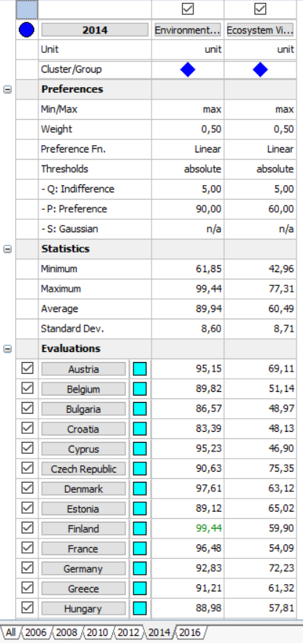
CASE STUDY – Visual PROMETHEE
Figure 3: the Visual PROMETHEE

Slide 14
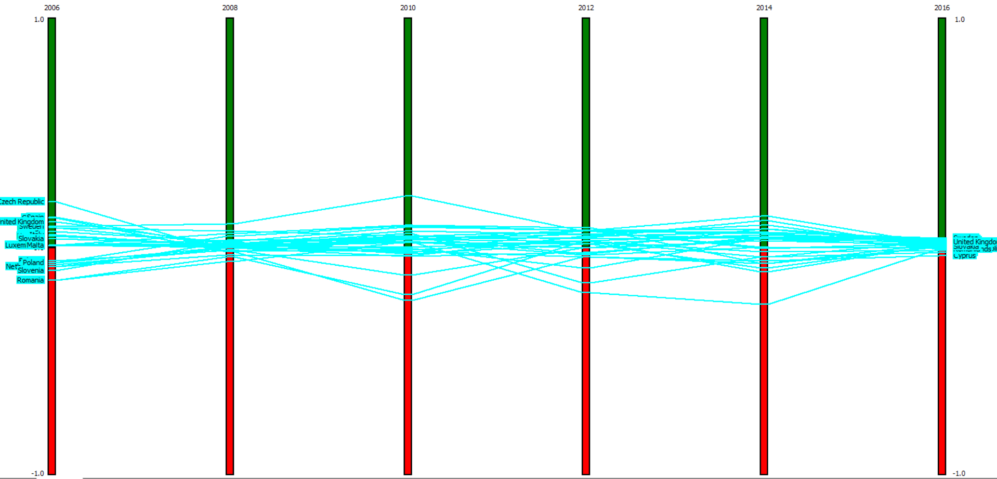
CASE STUDY – Visual PROMETHEE
Figure 4: Scenarios’ comparison

Slide 15
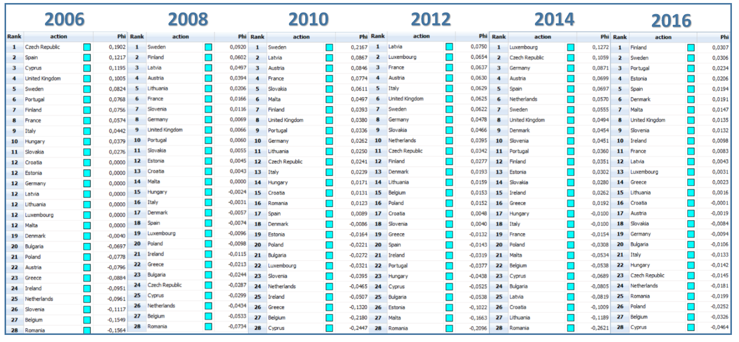
CASE STUDY – RESULTS
Table 2: Rankings & Global Flows

Slide 16
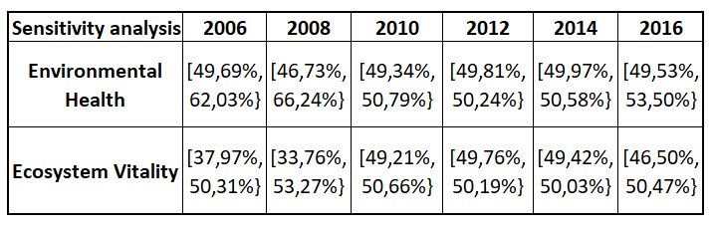
CASE STUDY
Sensitivity analysis
Table 3: Sensitivity Analysis
At 2006 and 2008 the intervals have a distance of about 20%, but at the following years are getting particularly limited.
This makes our solution quite sensitive to any change.
This may happens because the countries’ values are quite similar and therefore the margin for any change is quite limited.
In any case, these strict limits should be taken into account for the flexibility of our ranking.

Slide 17
CONCLUSIONS
Every ranking is different to each ranking of the EPI.
Many changes across the selected years.
The rankings are different every year, with small and big changes in the countries’ positions.
The transition from 2014 to 2016 is the most relatively stable.
All countries try to get improved.
All countries are in harmony with the European Union's pattern for a better quality of life for the EU citizens.

Slide 18
Thank you for your attention!

